Slide 1
The Battle of Neighbourhoods
- Jayasakthi Devaraj

Slide 2
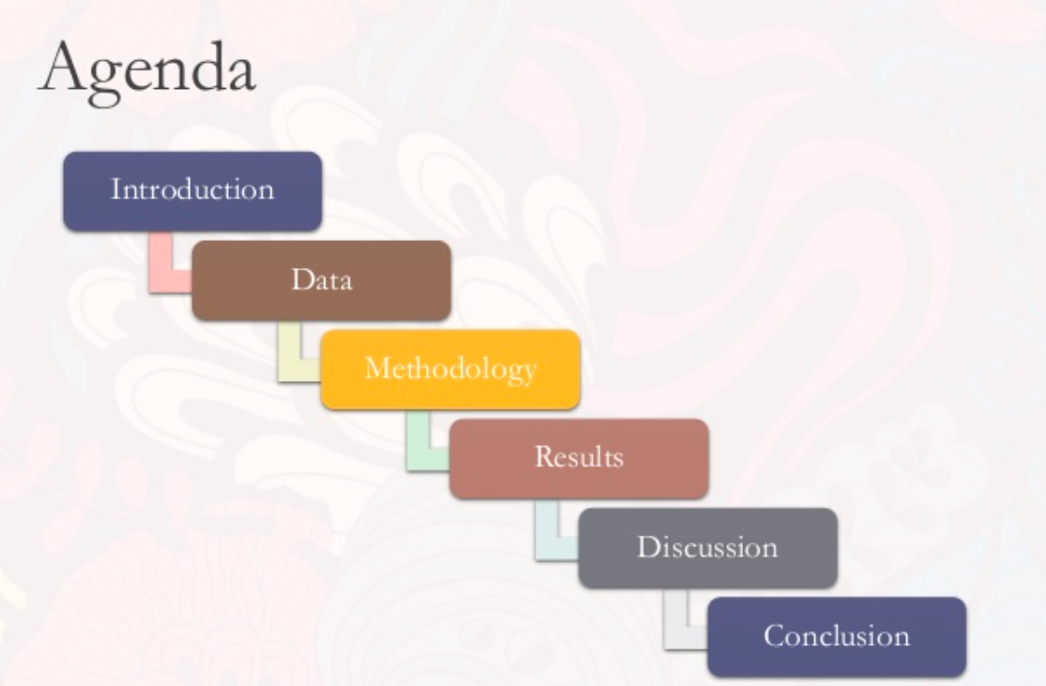
Agenda

Slide 3
Introduction and Business Problem
The objective of this capstone project is to find the most suitable location for the entrepreneur to open a new Indian Restaurant in Manhattan, New York. By using data science methods and tools along with machine learning algorithms such as clustering, this project aims to provide solutions to answer the business question: In Manhattan, if an entrepreneur wants to open an Indian Restaurant, where should they consider opening it?

Slide 4
DATA
To solve this problem, we will need below data:
● List of neighborhoods in Manhattan, New York.
● Latitude and Longitude of these neighborhoods.
● Venue data related to Indian restaurants. This will help us find neighborhoods that are more suitable to open an Indian Restaurant.

Slide 5
METHODOLOGY
● The loading of New York neighborhoods from new_york_dataset.
https://cocl.us/new_york_dataset
● Getting Latitude and Longitude data of these neighborhoods via
Geocoder package.
● Using Foursquare API to get venue data related to these
Neighborhoods.
● Performed the clustering method by using k-means clustering.I have clustered the neighborhoods in Manhattan,New York into 3 clusters based on their frequency of occurrence for “Indian food”.
Based on the results (the concentration of clusters), I will be able to recommend the ideal location to open the restaurant.

Slide 6
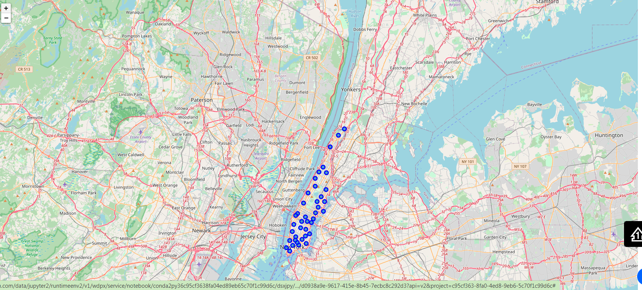
Plot of all Neighborhoods of Manhattan that were extracted:

Slide 7
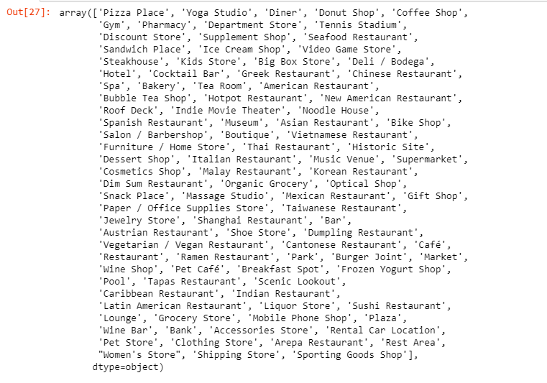
100 Unique Categories From Returned Venues

Slide 8
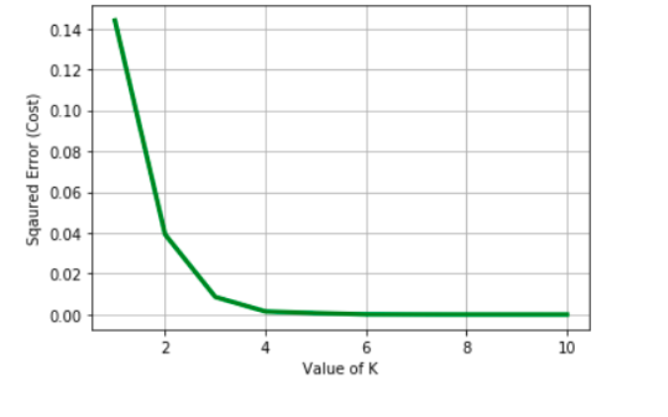
Clustering the Neighborhoods
From the Below image we see that best value of K will be 3 according to Elbow method.

Slide 9
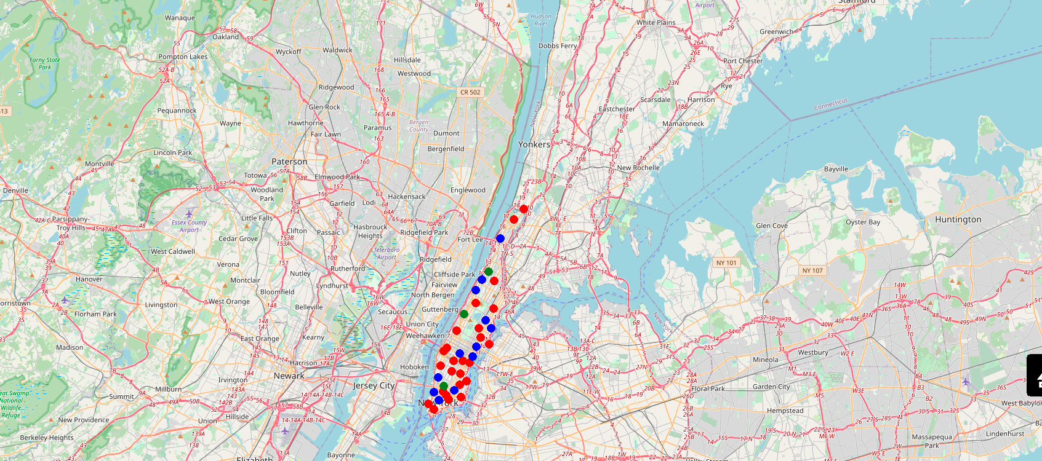
*k*-means to cluster the neighborhood into 3 clusters

Slide 10
RESULTS
The results from k-means clustering show that we can categorize Manhattan neighborhoods into 3 clusters based on how many Indian restaurants are in each neighborhood:
● Cluster 0: Neighborhoods with no Indian restaurants.
● Cluster 1: Neighborhoods with less number of Indian restaurants.
● Cluster 2: Neighborhoods with a more number of Indian restaurants
The results are visualized in the above map with Cluster 0 in green,
Cluster 1 in blue, Cluster 2 in red.

Slide 11
DISCUSSION
According to the analysis,Battery Park City will provide the least competition for an upcoming Indian restaurant as the International Airport is close to this neighborhood. So, all this is the best place for Indian immigrants for having lunch/dinner and the frequency of Indian restaurants is very low compared to other neighborhoods. Bayside has the highest number of Indian restaurant and *Hamilton Heights * is highly dense so, we will not open there.

Slide 12
CONCLUSION
Finally, to conclude this project, we have got a small glimpse fo how real-life Data science project looks like. I have used some frequently used python libraries to handle JSON file, plotting graphs, and other exploratory data analysis. Use Foursquare API to major boroughs of New York City and their neighborhoods. Potential for this kind of analysis in a real-life business problem is discussed in great detail. Also, some of the drawbacks and chances for improvements to represent even more realistic pictures are mentioned. As a final note, all of the above analyses is depended on the adequacy and accuracy of Four Square data. A more comprehensive analysis and future work would need to incorporate data from other external databases.

